Slide 1
HUMANITIES
Stepping up into Year 11

Slide 2
Geography Exam Structure
AQA 3 x 1 hour 30mins papers
Paper 1 – Living World (ecosystems, natural hazard)
Paper 2 – Human Geography (urban developments and global case studies)
Paper 3 – Field work (based on the recent trips) & Issue Evaluation

Slide 3
HISTORY Exam Structure
EDEXCEL 3 x papers
Paper 1 – Medicine in Britain with a study on the trenches (1hour 20mins)
Paper 2 – Early Elizabethan and American West (1 hour 50mins)
Paper 3 – Weimar and Nazi Germany (1 hour 30 mins)
Total /200

Slide 4
RE Exam Structure
AQA 2 x 1 hour 45 mins papers
Paper 1 – Beliefs and Teaching and Practises (Christianity and Islam)
Paper 2 –Themes:
A - Relationships and Family
B – Religion and Life
D – Religion, Peace, Conflict
E – Religion, Crime, Punishment

Slide 5
Barriers to success in Humanities
Dealing with the amount of content across each subject
Remembering tier 3 words for each subject
Learning the expectations of each question
Understanding how to write extended essays
Time management

Slide 6
Barriers to success in Humanities
Dealing with the amount of content across each subject - use revision materials provided to break down content to revise, revise, revise. Attend intervention sessions
Remembering tier 3 words for each subject – focus each lesson on the new learning; practise this at home; use the new words as often as you can.
Learning the expectations of each question -
Use the revision material, in lesson support to learn the techniques by heart
Understanding how to write extended essays
Ask for past papers/questions and practice at home; use AI for model answers before you practise
Time management - in class, build the resilience by completing exam questions as quick as possible; complete past questions in exam conditions

Slide 7
Revision SCHEDULE
GEOG | HISTORY | RE
SCHOOL WORKBOOKS QR CODES WITHIN THE BOOKLETS ONLINE SUPPORT AND BLENDED LEARNING FLASHCARDS | REGULAR REVISION HW USE REVISON GUIDES USE ONLINE SUPPORT IN BLENDED LEARNING SENECA LEARNING | COMPLETE HW’S – REVISION FOCUS USE BLENDED LEARNING FOR RESOURCES BBC BITESIZE IS A USEFUL REVISON TOOL

Slide 8

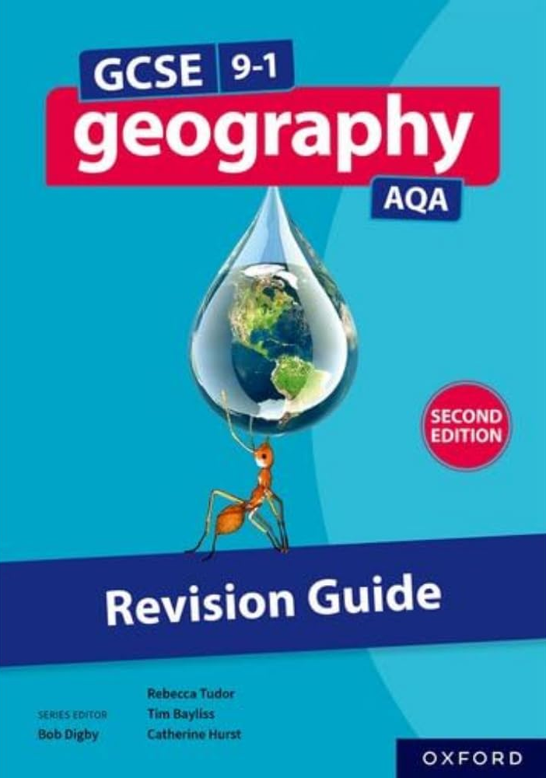
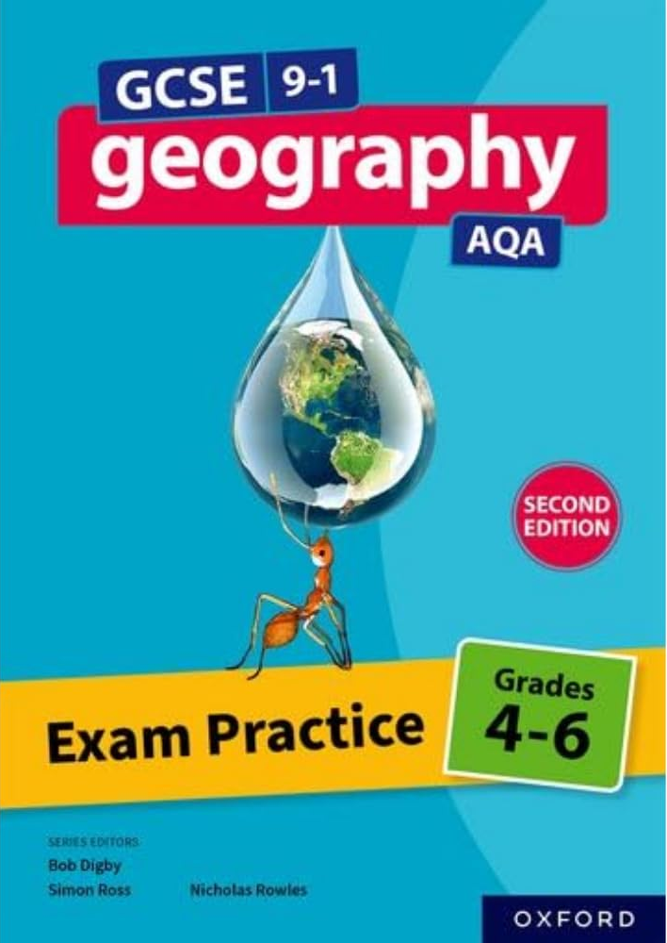
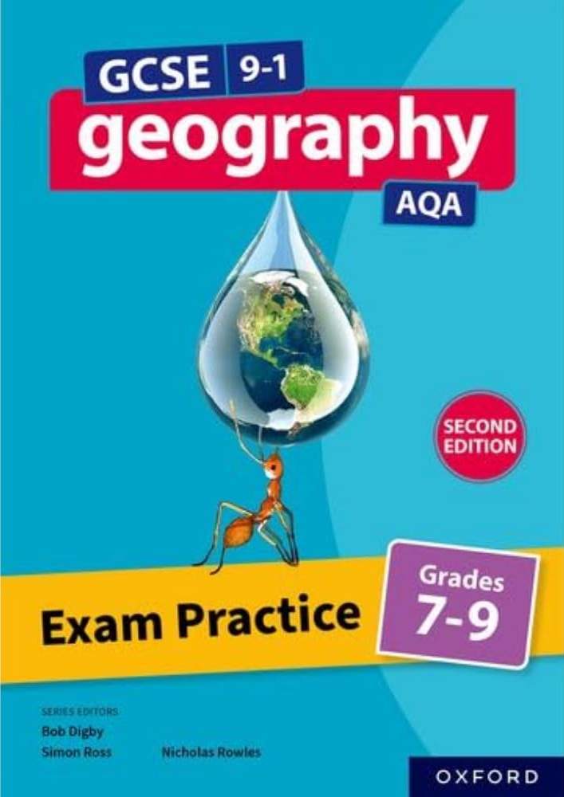
Revision Guides and Workbooks
GEOGRAPHY

Slide 9
Revision Guides and Workbooks
GEOGRAPHY
EACH STUDENT ALSO HAS ACCESS TO KO AND REVISON MATERIALS FOR EACH PAPER
THEY NEED TO SEE MR DIXON IF THEY DO NOT HAVE A COPY

Slide 10
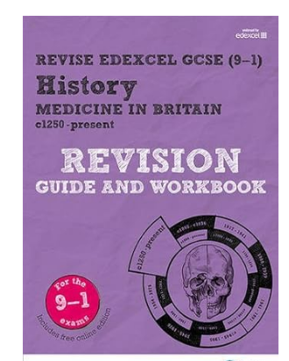
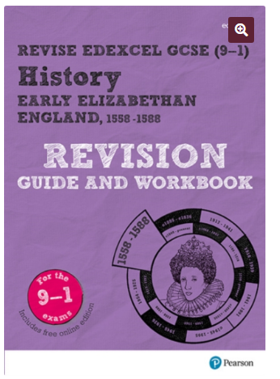
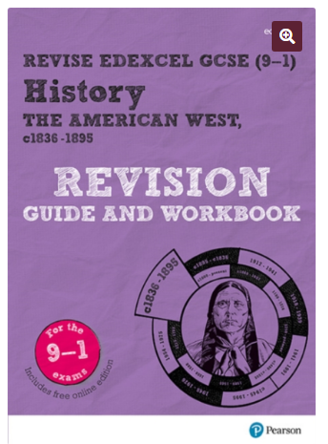
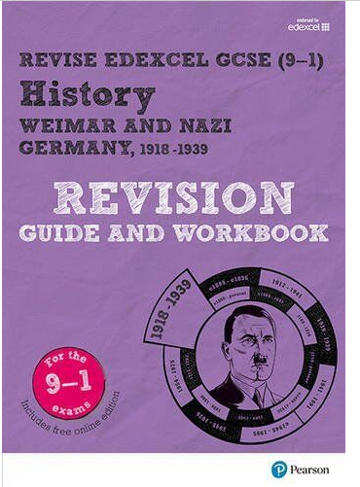
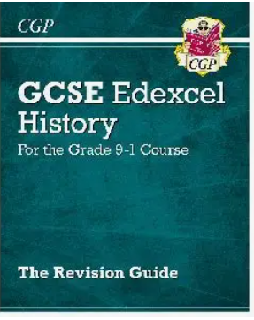
Revision Guides and Workbooks
HISTORY
Medicine in Britain
Early Elizabethan
American West
Weimar and Nazi Germany

Slide 11
Revision Guides and Workbooks
HISTORY
EACH STUDENT ALSO HAS ACCESS TO A SET TEXT BOOK AND A REVISON GUIDE
THEY NEED TO SEE MISS ROWE IF THEY DO NOT HAVE A COPY

Slide 12
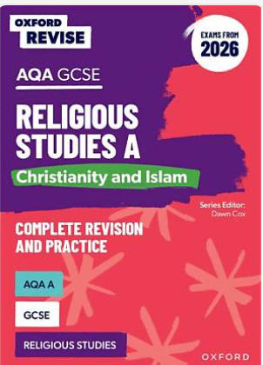
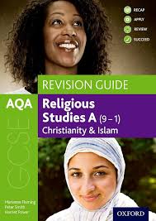
Revision Guides and Workbooks- RE

Slide 13
MOCK EXAMS
Students will be given papers that cover some of the topics that have been covered so far.
Importantly, support will be given to direct students in their revision.
It is important this is covered now so that it can be recalled in the summer more easily.
Humanities subjects are heavy in content and nothing can be left out.
Students will be given feed back and they must act upon this

Slide 14
Why success matters
Short term:
You should be aiming to at least meet your minimum target grade in each subject.
Colleges ask for minimum grades. The more grades above 4 (hopefully 5) the more chance of hitting your conditional offer. Don’t leave it to chance on the day.
If you want to do these subjects at A Level, minimum requirements are often a Grade 6
Long term:
You carry these grades with you.
You want to look back with no regrets.

Slide 15
We are here to support you!
Targetted Intervention - form times for select students
After school later in the year as needs dictate
In class support
Lessons planned to the specification.
Regular testing of knowledge.
Practise exam skills.
Constant monitoring and then high expectations in class.
Out of class support
Online GCSE Past papers – regular practice.
Online revision videos – ask teachers for guidance here - Email staff.
Revision Guides and Workbooks.

