Slide 1
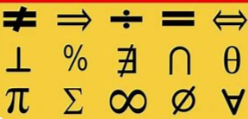
Mathematics
Stepping up into Year 11

Slide 2
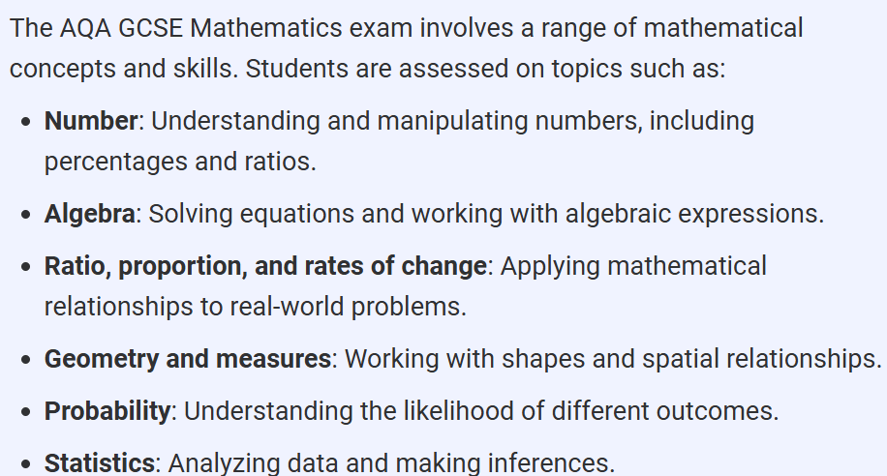
What is Involved?
There are 3 papers – Each 1 hour and 30 minutes – 2 of which are calculator papers, covering a variety of skills and topics.

Slide 3
Exam Structure
3 x 90 minute papers
Paper 1 – Non-Calculator – 80 marks max – No Multiple Choice
Paper 2 – Calculator allowed - 80 marks max – No Multiple Choice
Paper 3 – Calculator allowed – 80 marks max – No Multiple Choice
Total / 240

Slide 4

Barriers To Success
Improve Confidence
Complete your Mathswatch paper every week – these are shadow papers of real papers.
Attend Maths Masterclass Sessions – Every Thursday (Week B) – 3.05 – 4pm
Attend Flying Start – Every Monday and Friday 8am – 8.30am
Lack of Confidence
Saying I can’t do maths
Not trying a question
Practice, Practice, Practice – this will improve confidence
Try every question – one mark is better than no marks.

Slide 5
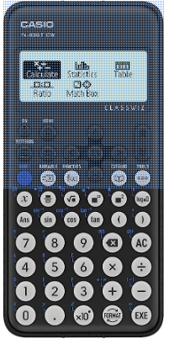

Barriers To Success
No Calculator in lessons or exams
Different models of calculators work in different ways and do different things, it is important that pupils know the calculator they are going to use in their exams.
No Method
Full clear method needs to be shown on all questions, including when using a calculator.
Illegible and scattered method is one of the key concerns of examiners in the latest exams.

Slide 6
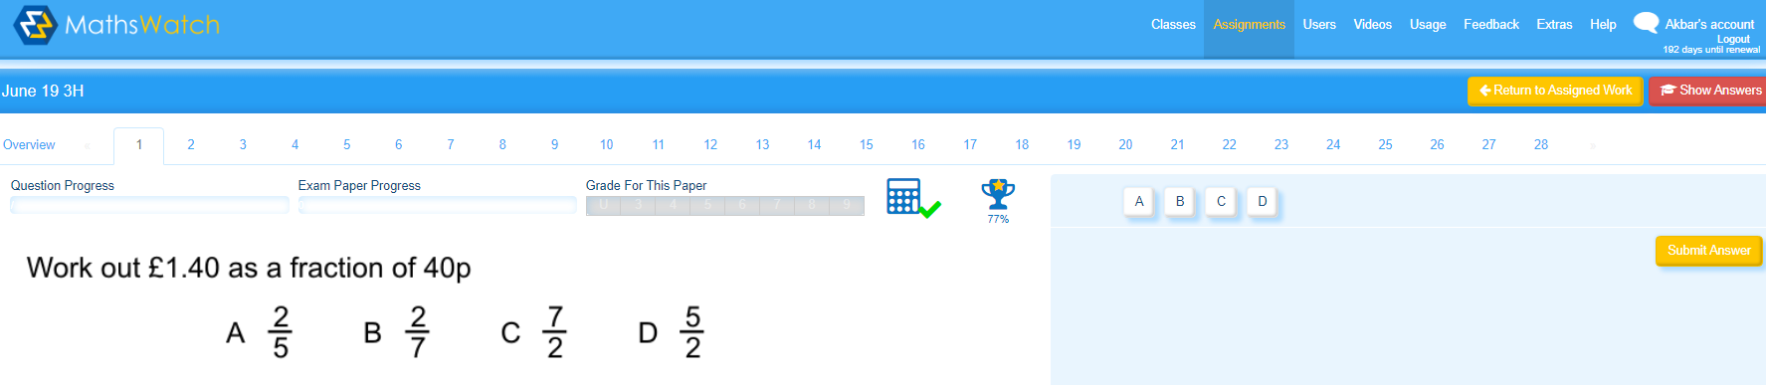
Mathswatch AQA Papers
These are to be completed on a weekly basis, with teachers setting pupils a minimum expectation, this is to ensure that all pupils fulfill their potential

Slide 7
MOCK EXAMS
November 2026 – Full mock – QLAs to follow – students MUST act on these – Mathswatch/ Maths Genie/ Corbett Maths
March 2027 – Full final mock – QLAs again to follow – again students MUST act on these – Mathswatch/ Maths Genie/ Corbett Maths
Around early April/May 2027 ……. predicted papers appear online, on websites such as Corbett Maths and Onmaths – students should complete all of these asap, and bring any queries to their maths teacher

Slide 8
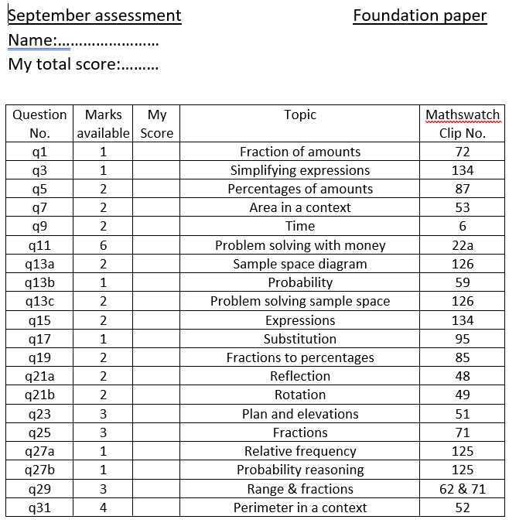
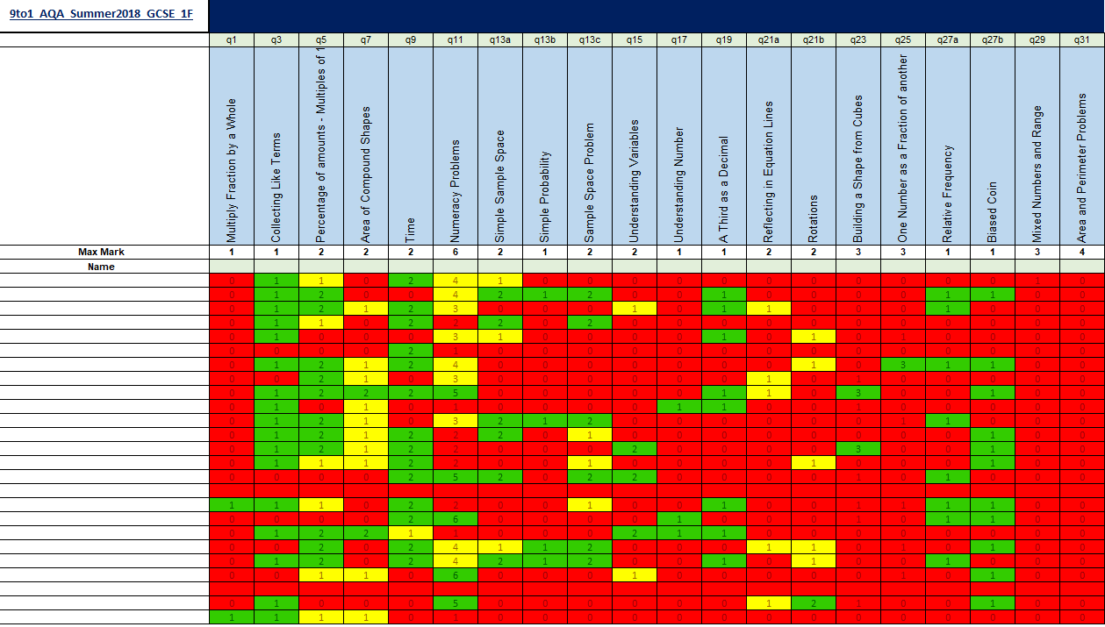

Slide 9
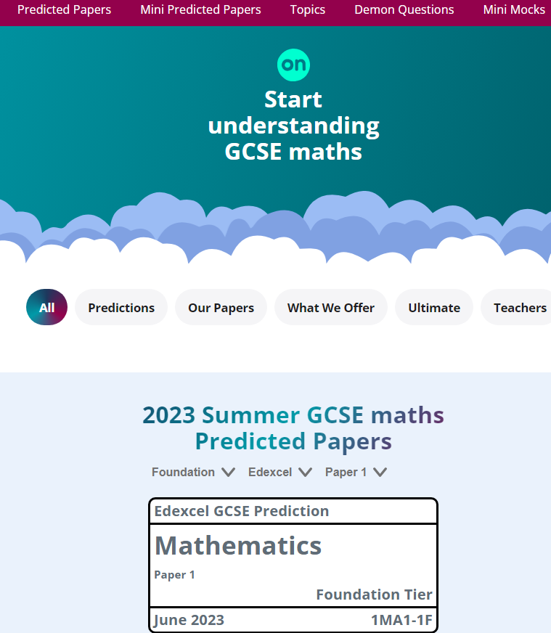

Slide 10
Why success in maths is crucial
If you do not achieve at least a Grade 4, you will HAVE to resit your Maths GCSE at college in November. If you do not achieve at least a grade 4 in that resit exam, you will HAVE to resit it again in June. This will continue until you make the grade
Same is true for English Language
You should be aiming to at least meet your minimum target grade in each subject

Slide 11
We are here to support you!
Thursday afternoon Maths Masterclass (Week B)
Flying Start – Every Monday and Friday 8am – 8.30am
Easter booster classes
Weekly Mathswatch exam papers set
GCSE Past papers – regular practice (available from the pigeonholes in the foyer)
Mathswatch revision videos

Slide 12
GCSE Maths exam dates
Paper 1(Non- Calculator)
Friday 14 May 2027 (AM)
Paper 2 (Calculator)
Thursday 27th May 2027 (AM)
Paper 3 (Calculator)
Monday 14 June 2026 (AM)

Slide 13
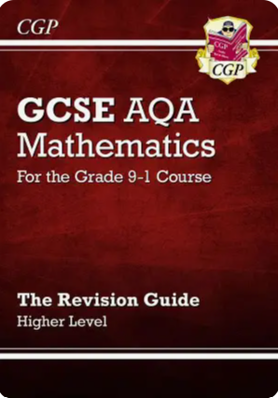
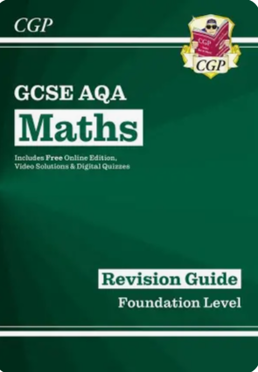
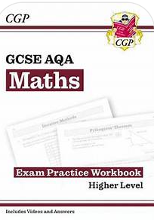
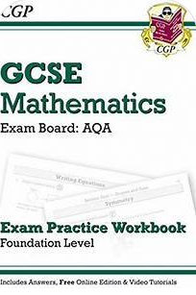
Resources Available
Revision Guides and Exam Prac - £3 each. Available from your maths teacher

Slide 14


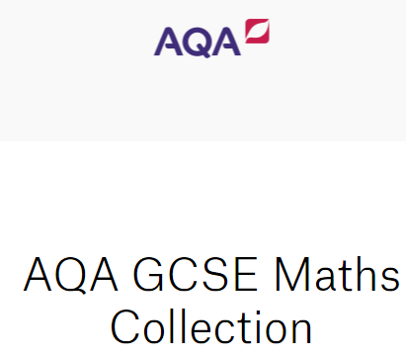


Slide 15
