Slide 1








GCSE English Language and Literature
Importance of our broad English Curriculum
Developing wider literacy and grammar skills - to help students access content across all subject areas
SCIENCE
HISTORY
Building skills linked to success outside of school – oracy and reading
RELIGIOUS
EDUCATION
Also have subject specific content to cover for two GCSE subjects
What’s really involved?
Notes:
Utilises knowledge associated with other subject areas: History, Religious Studies, Sociology, Science…
Always been seen as teaching skills that are integral to success in other subjects and the wider world!
Broadening of the curriculum - Increased the pressures

Slide 2





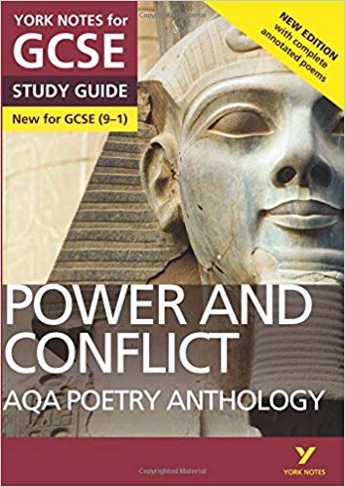
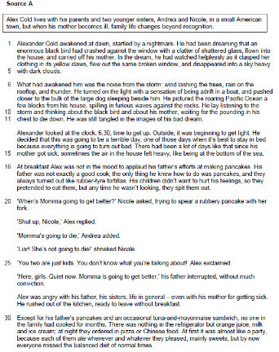


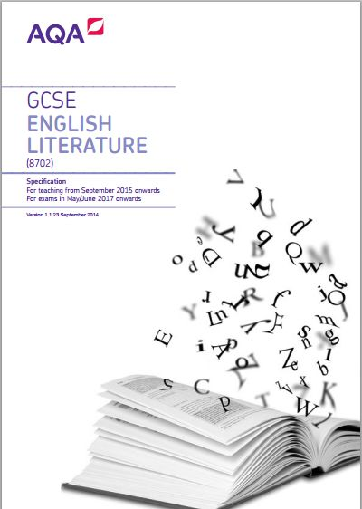

GCSE English Language and Literature
Did you know?
All
closed
book
7 and a half hours
MOCK
EXAM
CYCLE
Pre-19th Century text
Shakespeare Text
20th Century Text
15 Poems (including
Pre-19th Century)
Analysing extracts from unseen texts – fiction and non-fiction
4 Academic Essays
Creative Writing
Non-fiction Writing
Exam Papers:
2 Language
2 Literature

Slide 3

Biggest Barriers to Success:
GCSE English Language and Literature
Dealing with the increased amount of content across Language and Literature
Remembering plot, character and finer details across all GCSE Literature texts
Poetry - both the anthology and unseen
Learning the expectations of each question
Time management
How do I revise for English?

Slide 4



Support to Overcome Barriers:
Learn the ‘OSCA approach’ to every exam question – they work!
Re-read Literature texts – content heavy.
Additional independent research and notes – including online materials accessed through website/ foyer.
Complete homework/revision tasks – teachers will also mark any additional exam responses that students attempt!
Ask for additional resources that you can work through at home with parental support, if needed.
Attend any extra intervention or 1:1 sessions – revise early!
Take stepping stone assessments seriously.
Unique to OSCA:
Approaches
Expert knowledge – rote learn
Stepping stone assessments

Slide 5

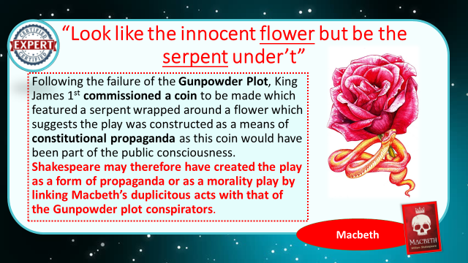
Expert Knowledge:
Written by OSCA teachers
Links to exam specification
Unique and sophisticated engagement with the texts
Challenges students to consider the text’s position in relation to the wider world
Can you:
Ask students about their expert knowledge.
Help students to rote learn this? Every detail matters!
Test students at home.
Grade 9 Vocabulary encompasses:
Vocabulary linked to history
Vocabulary linked to sociology
Vocabulary linked to science
Vocabulary linked to religious education

Slide 6

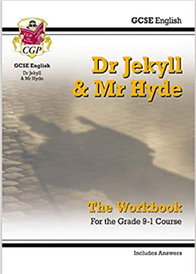
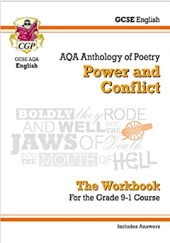




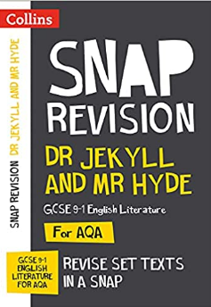
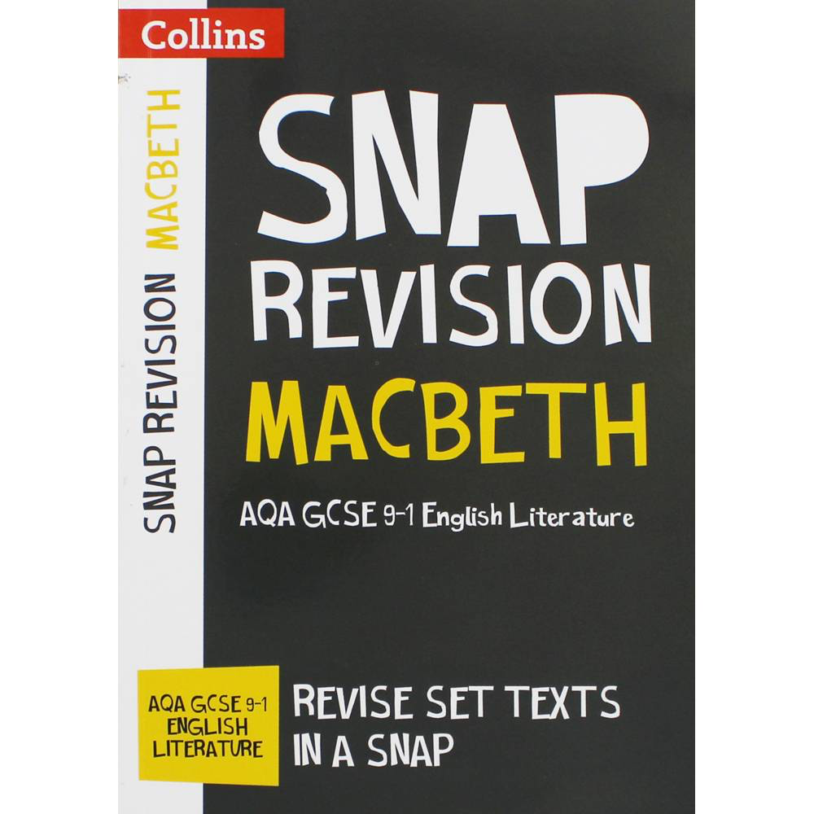
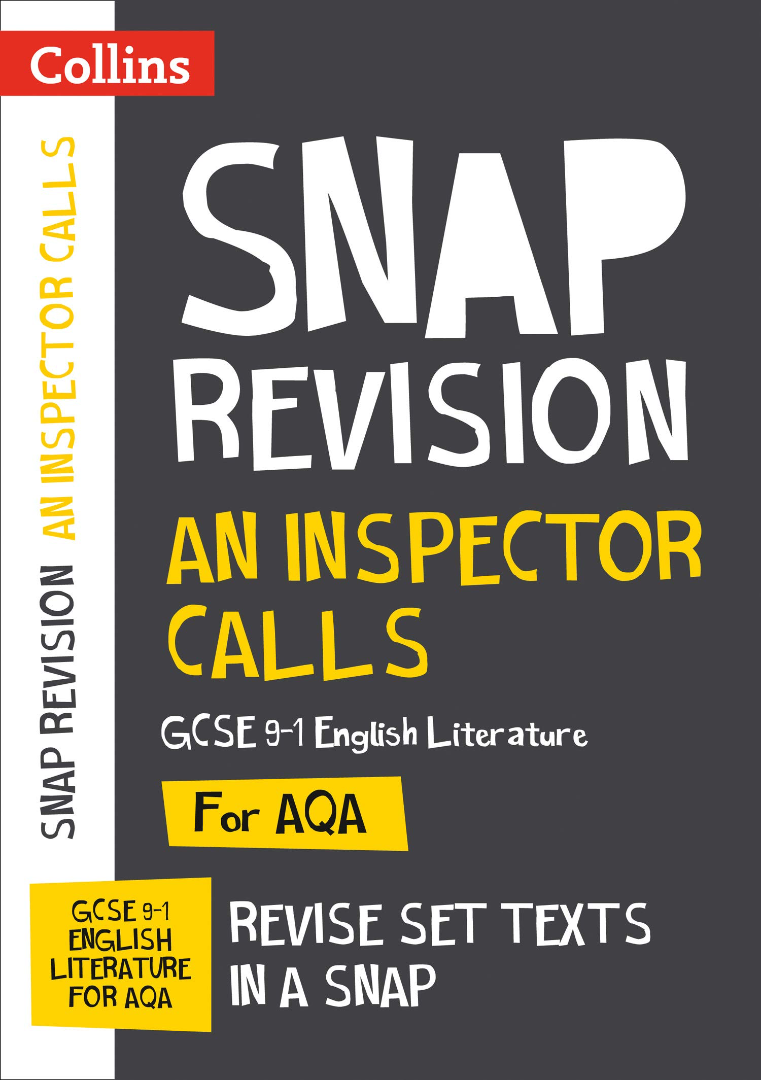
We have lots of resources available for students if they need them.
We will identify students who may need this!
Students must also come and speak to their teacher individually if they feel they need additional support.

